Slide 1



Activity
6
M3
WORKS
M3 works

Slide 2
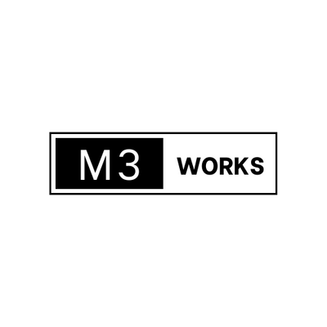
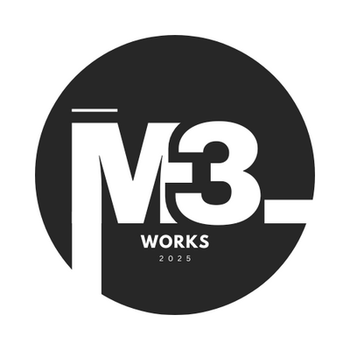

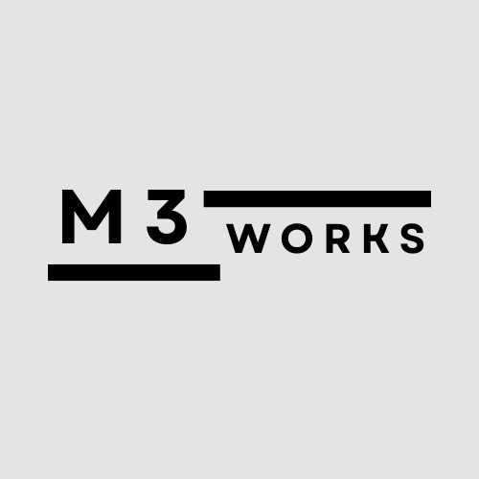
01
02
04
03
Draft
Team Logo

Slide 3
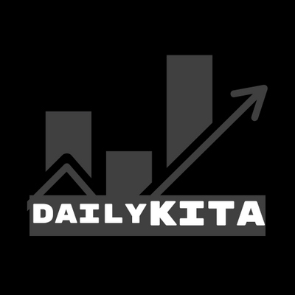
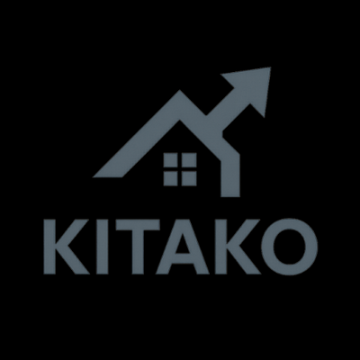

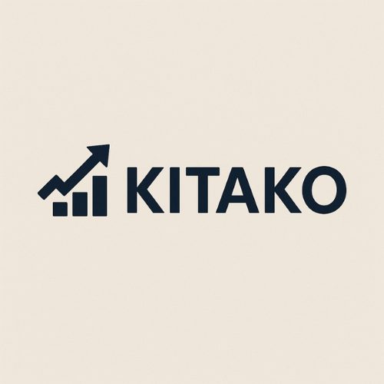
01
Assessment
02
Vision
04
03
Implementation
Roadmap
Project logo
Draft

Slide 4



Meaning Behind the Design:
The M3 suggests a group or a trio, symbolizing teamwork and innovation. The word WORKS" emphasizes productivity and action. The two bold lines represent structure and connection, showing a clear path from concept to output.
Why This Works:
The minimalist layout gives it a clean and modern look, suitable for tech or business. The black on gray color scheme shows professionalism. The composition is balanced, making the design feel solid and trustworthy.
M3 Works
Gestalt Principles Used:
Final Logo
Proximity: Groups “M3” and “WORKS” clearly, showing their connection.
Continuation: The top line leads the eye smoothly across the logo.
Similarity: Uniform color and shape make the elements feel cohesive.
Figure-Ground: Black elements stand out strongly from the light background, ensuring clarity.

Slide 5
Meaning Behind the Design:
The rising bar chart with an arrow perfectly represents income, growth, and financial progress a direct visual connection to the meaning of “KITAKO” (My Income). It symbolizes improvement and success in managing or earning money.
Why This Works:
The logo is simple, clean, and direct. The use of bold, modern text ensures readability, while the icon adds a strong visual identity. The dark blue or black colour conveys trust and professionalism, ideal for a finance-related project.
KITA KO
Gestalt Principles Used:
Similarity: The consistent colour ties the icon and text together as one brand.
Continuation: The upward arrow leads the eye naturally toward the name.
Proximity: The icon is close to the text, reinforcing their connection.
Figure-Ground: The bold icon and text stand out well from the light background, making it clear and easy to read.
FInal logo

Slide 6

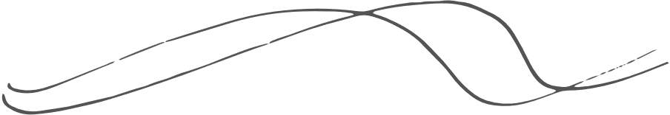
M3 Works
Momentum Works
M3 was named by three friends who shared a passion for technology and business. When they started their journey together, they wanted a name that reflected their unity and drive. Since there were three of them, they chose the letter “M” to represent their shared core value — Momentum — and the number 3 to symbolize the trio.
Momentum stands for their constant energy and determination to keep pushing forward, innovating, and growing in the fast-paced world of technology and business. The name M3 reminds them to maintain their drive and never lose the pace in achieving their goals.
Summary
The “M3 Works” logo blends clean design with visual principles to express teamwork, professionalism, and innovation a strong identity for a future-focused group.

Slide 7

Fun Fact
KITA KO
Name of Origin
Name was Born
The name “Kita Ko” in Filipino means “my income” — but it can also sound like “I saw” in casual conversation.
That makes KITAKO a clever brand name that speaks both to earning money and clearly seeing your financial goals. It's like saying:
Catch Phrase
Summary
I see it. I earn it. I own it.
The KITAKO logo effectively communicates income growth and reliability through a clean design and strong visual cues. Gestalt principles help make it cohesive, clear, and memorable.

Slide 8


Challenges and Barriers on
Lack of Income Awareness and Financial Control
Untracked or Accident Overspending Income Sources
Lack of Motivation to Earn More and Forgotten Side Hustles
Many people earn from different sources (e.g., salary, freelance, side hustle) but don’t track how much they really make. without seeing income clearly, users may spend more than they earn.
People don’t notice their growth or progress, which can demotivate them from small earnings from gigs or tips often go unrecorded or forgotten.
No Proof of Consistent Earnings
Difficulty in Building Financial Discipline
Freelancers and informal workers struggle to show income when applying for loans or budgeting.
Many people struggle with developing consistent money habits due to lack of structure, reminders, or simple tools.

Slide 9



Kita Ko
Kita Ko is a lightweight, user-friendly income tracker app that empowers users to take full control of their finances. It solves the root problem of income unawareness and poor financial habits by offering a central platform to:
Promote Collaboration
Log all income sources — from salaries to side hustles
Display real-time total earnings for smarter decision-making
Track income history to visualize financial growth
Build discipline through consistent logging and review
Capture even small, mobile earnings instantly
Act as a digital income proof for budgeting and credibility
Your App Will Help Users:
Kita Ko
Become more aware of how much they earn
Spend more wisely based on actual income
Stay motivated by seeing progress over time
Develop better money habits and self-discipline
Record and present their earnings — anytime, anywhere
A Personal Income Awareness App

Slide 10
M3 WORKS
KITA KO
With Kita Ko, you’re not just building an app —you’re helping users see, understand, and take control of their income.

Slide 11

Meet the Members
M3 WORKS
DARYLL DAVE R. MASAPA
UNKNOWN
UNKOWN

